Slide 1
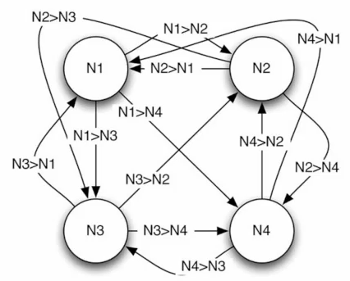
Tutorial 6
﻿CS5486 Intelligent Systems:
Associative Memory
and Hopfield Network
Hongzong Li
Department of Computer Science City University of Hong Kong

Slide 2

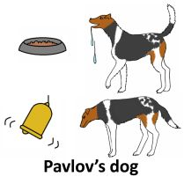
Associative Memory | Hopfield Neural Networks | AM & HNN
Artificial Intelligence (AI) systems often require the ability to recall patterns from partial or noisy inputs.
Associative memory enables this capability, allowing systems to retrieve complete patterns based on partial information.
Hopfield Neural Networks (HNN) are a foundational model for implementing associative memory in AI.
Definition: Associative memory refers to the ability to retrieve complete patterns from partial or noisy inputs

Slide 3
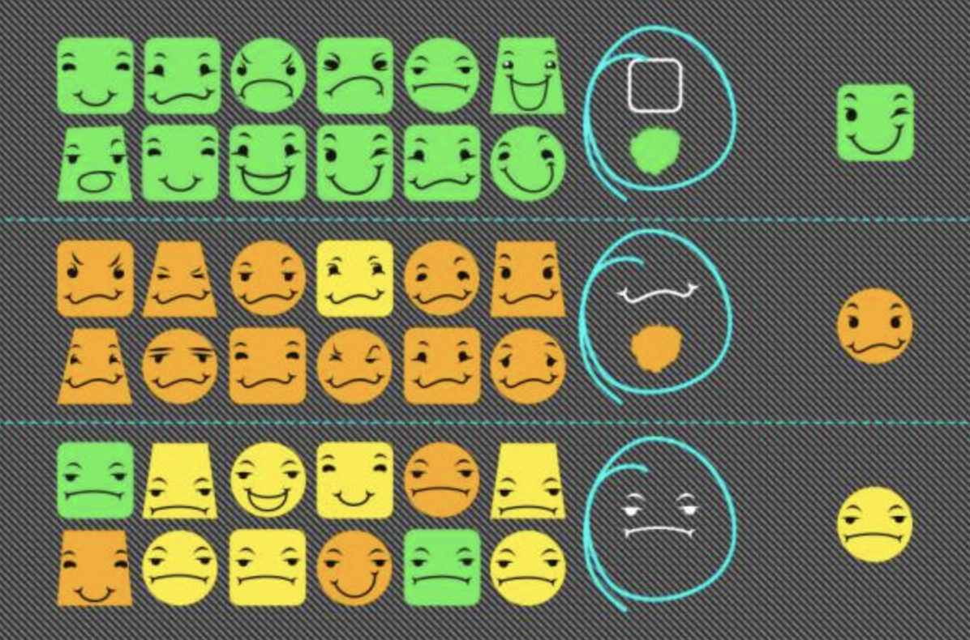
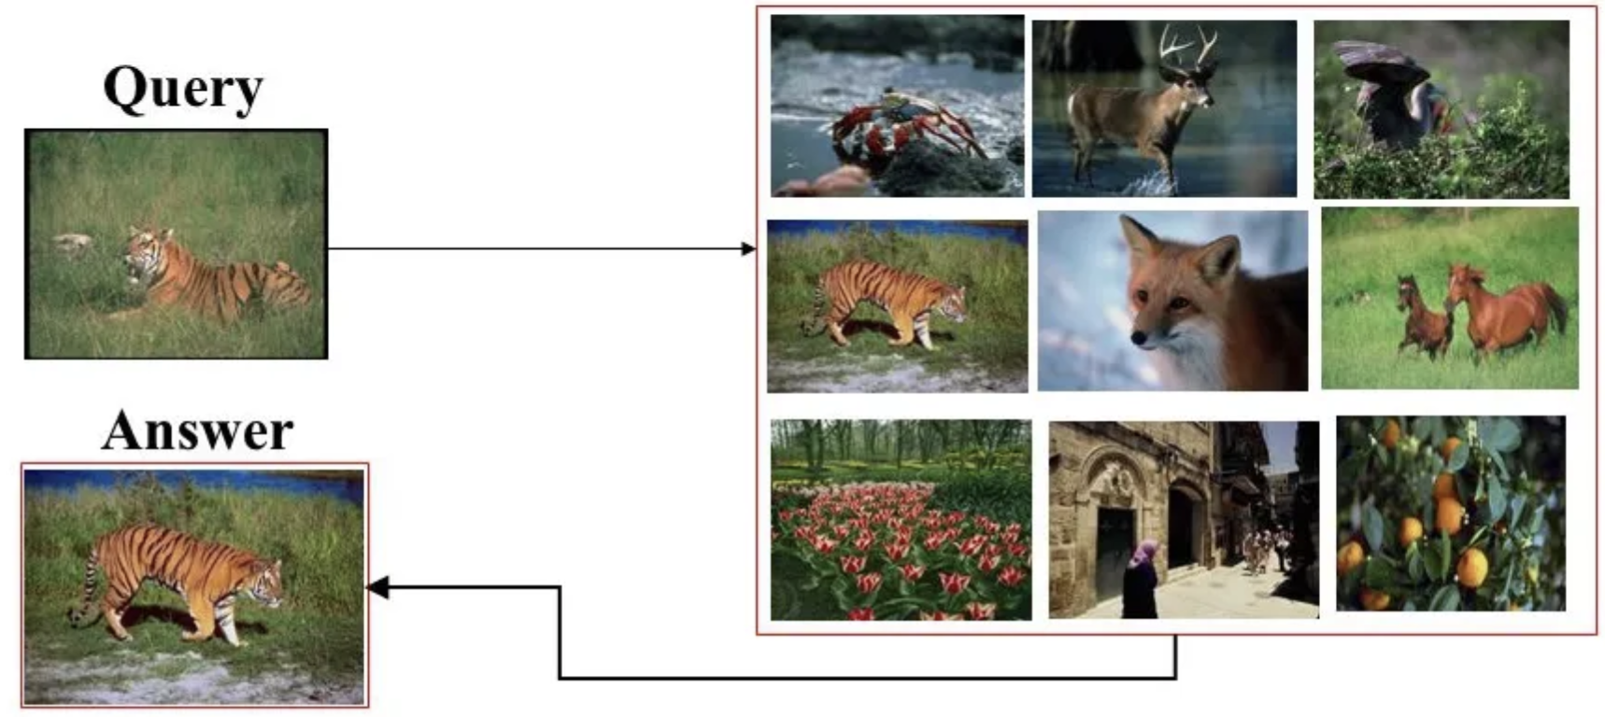
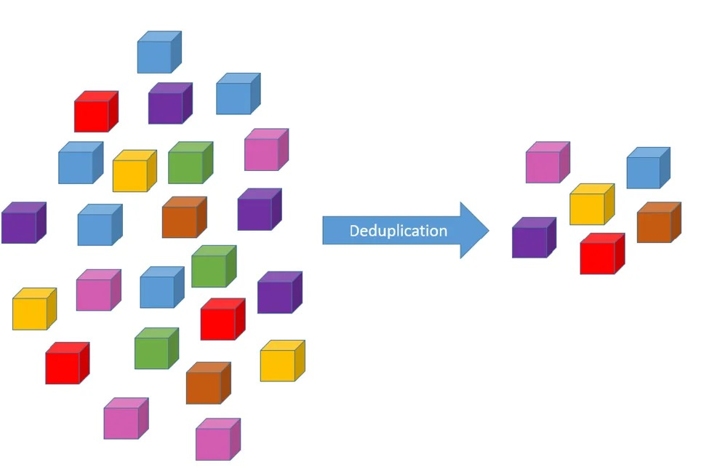
Associative Memory | Hopfield Neural Networks | AM & HNN
Applications
1. Pattern recognition
2. Image retrieval
3. Data deduplication:
Quickly detecting duplicate data within a large dataset by comparing new data to existing entries in an associative memory.

Slide 4
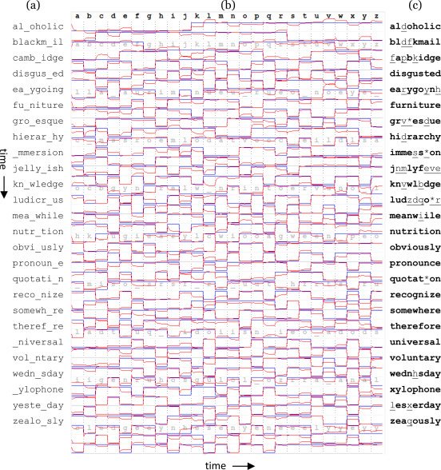
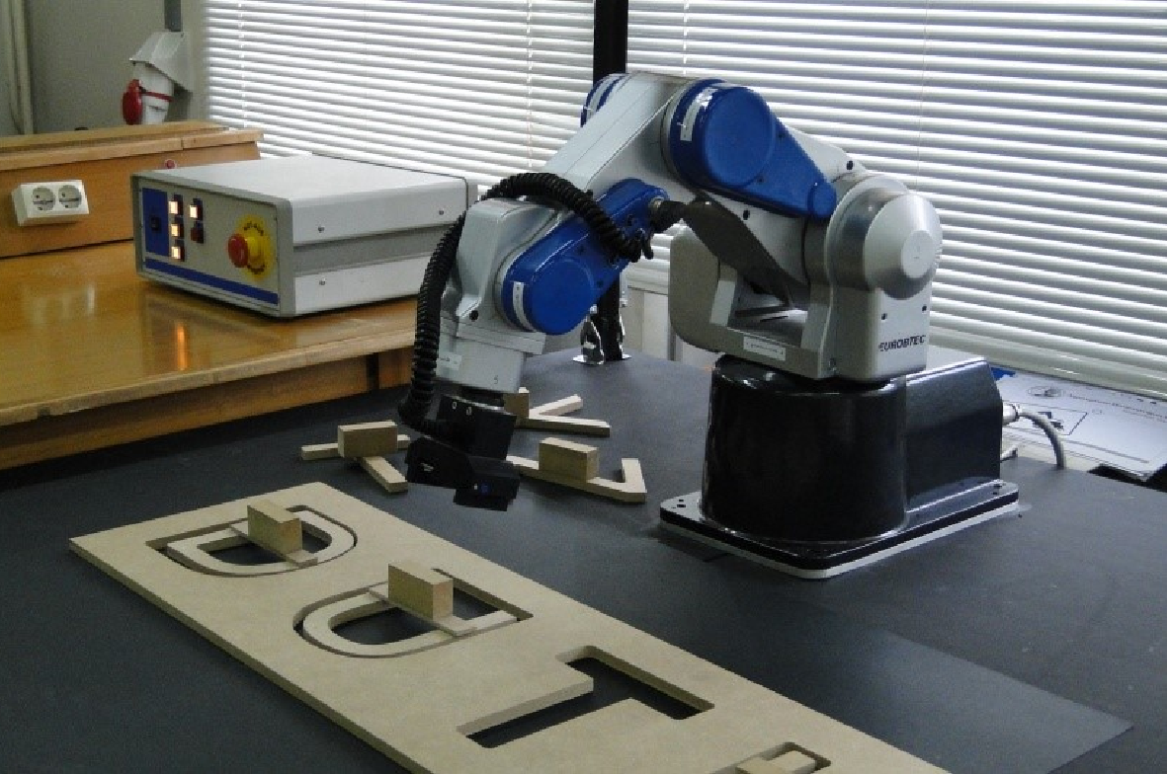
Associative Memory | Hopfield Neural Networks | AM & HNN
Applications
4. Natural language processing:
Recognizing misspelled words or incomplete sentences by using associative memory to find the closest match in a vocabulary [1].
5. Robotics:
Associating sensor data with actions or environmental states to enable robots to make informed decisions based on their perception.
[1] Kage, H. (2023). Implementing associative memories by Echo State Network for the applications of natural language processing. Machine Learning with Applications, 11, 100449.

Slide 5
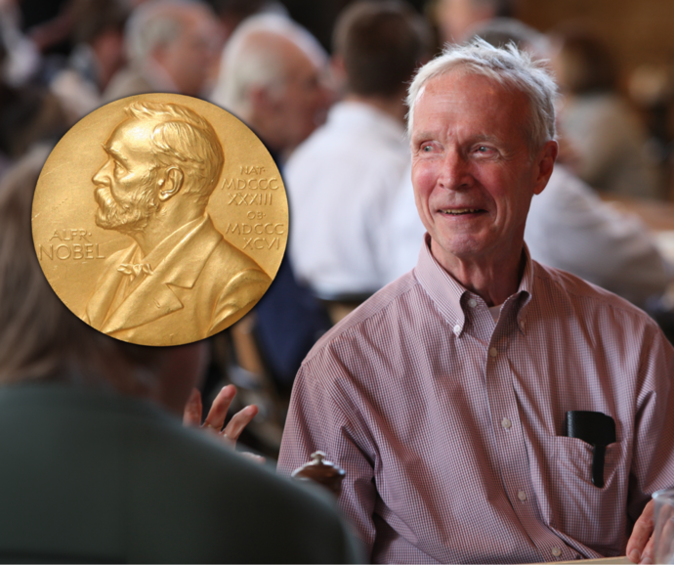
Associative Memory | Hopfield Neural Networks | AM & HNN
Hopfield Neural Network (HNN) is a form of recurrent neural network, consists of a single layer of neurons, where each neuron is connected to every other neuron except itself.
Structure
Consist of a single layer of fully connected neurons.
Each neuron is connected to every other neuron, with symmetric weights.
John Joseph Hopfield (born July 15, 1933),
Princeton University,
Functionality
Store patterns as stable states (attractors).
Retrieve stored patterns from partial or noisy inputs.

Slide 6
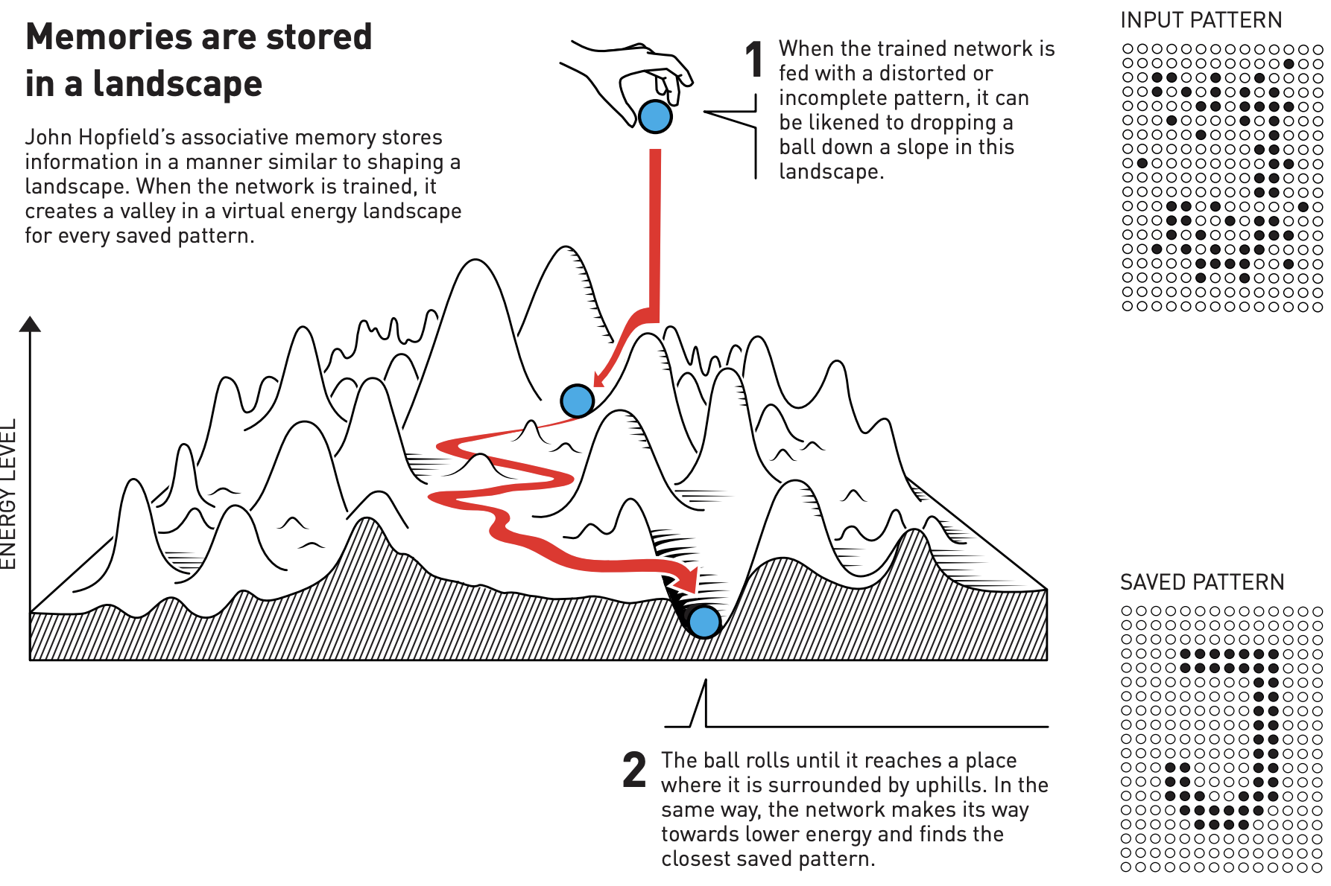
Associative Memory | Hopfield Neural Networks | AM & HNN
www.nobelprize.org: Using physics to find patterns in information
https://www.nobelprize.org/uploads/2024/10/popular-physicsprize2024-2.pdf
Notes:
John Hopfield’s associative memory model visualizes stored memories as valleys in an energy landscape. When the network is given a partial or distorted input (dropping the ball), it “rolls” through the landscape until it settles in the nearest valley, representing the closest stored memory. This process allows the network to restore incomplete or noisy data by finding the pattern with the lowest energy.

Slide 7
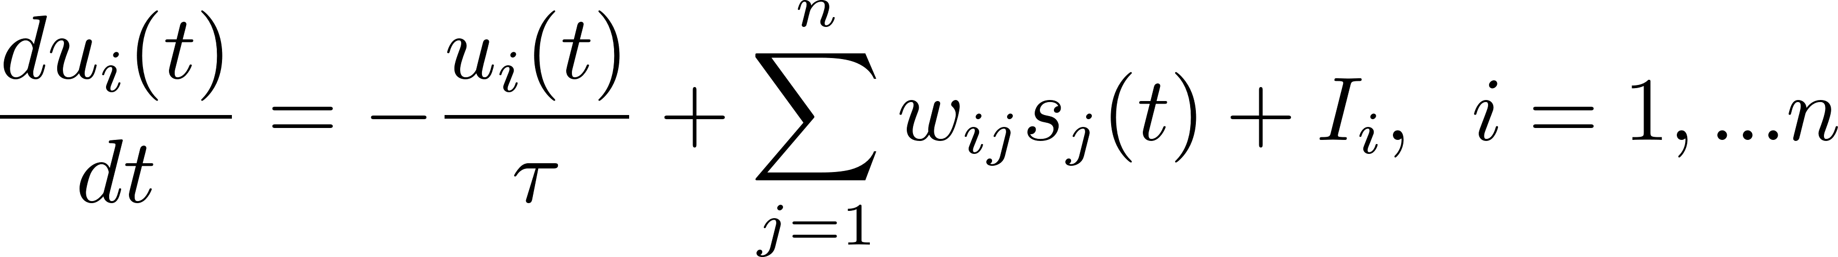
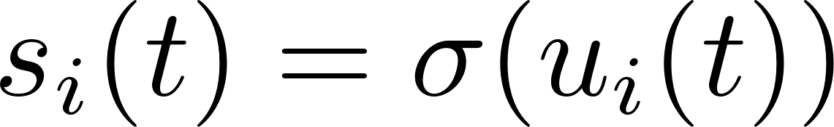
Associative Memory | Hopfield Neural Networks | AM & HNN
Energy Function: HNNs utilize an energy function to describe the network's state. The network evolves to minimize this energy, converging to a stable state that represents a stored pattern.
For discrete-time HNN
For continuous-time HNN
Each neuron's state is updated based on the weighted sum of its inputs.
Convergence → A stored pattern

Slide 8
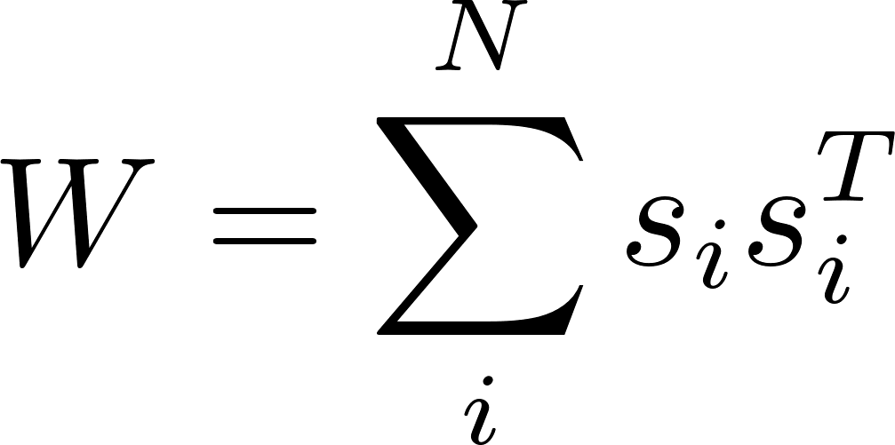
Associative Memory | Hopfield Neural Networks | AM & HNN
Associative memories are one of the earliest artificial neural models dating back to the 1960s and 1970s. Best known are Hopfield Networks, presented by John Hopfield in 1982. As the name suggests, the main purpose of associative memory networks is to associate an input with its most similar pattern. In other words, the purpose is to store and retrieve patterns.
In classical Hopfield Networks these patterns are polar (binary)
The weight matrix W stores the patterns, which can be retrieved starting with a state pattern s(0)

Slide 9
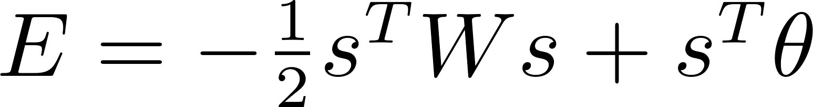
Associative Memory | Hopfield Neural Networks | AM & HNN
minimizes
Update rule:
energy function:
Convergence properties
For asynchronous updates with w_{ii} ≥ 0 and w_{ij} = w_{ji}, the updates converge to a stable state.
For synchronous updates with w_{ij} = w_{ji}, the updates converge to a stable state or a limit cycle of length 2.

Slide 10
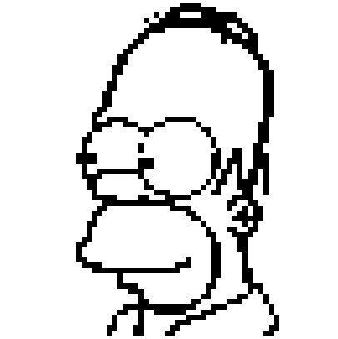
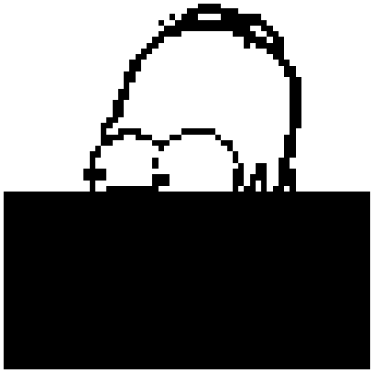
Associative Memory | Hopfield Neural Networks | AM & HNN
Consider a black and white image x_{homer}:
HNN
Notes:
the outer product of this black and white image

Slide 11
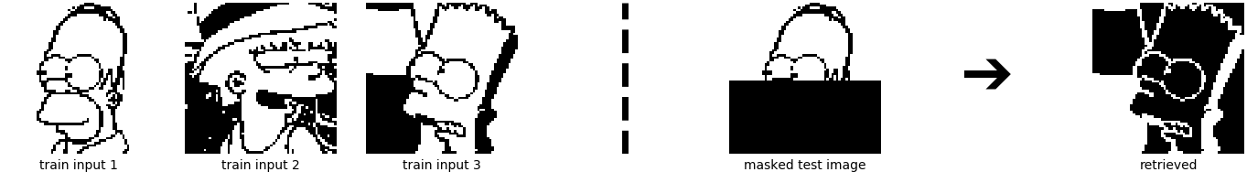
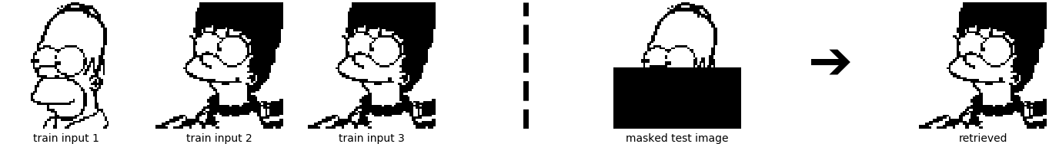
Associative Memory | Hopfield Neural Networks | AM & HNN
more than one pattern?
no longer perfect!

Slide 12
Associative Memory | Hopfield Neural Networks | AM & HNN
Why?
no longer perfect!
Masking the original images introduces many pixel values of −1
if no bias vector is used, the inverse of the pattern, i.e. flipping all pixels at once, results in the same energy.

Slide 13
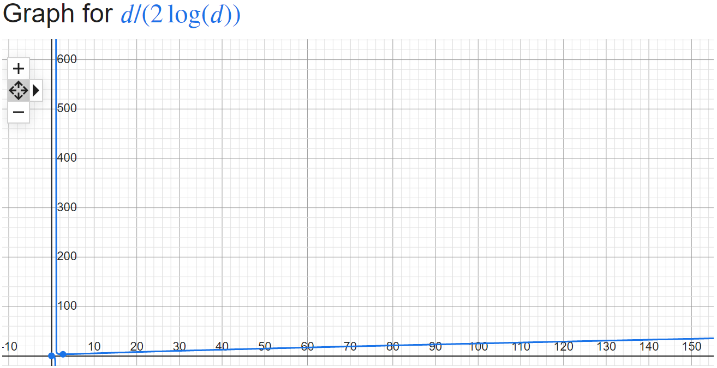
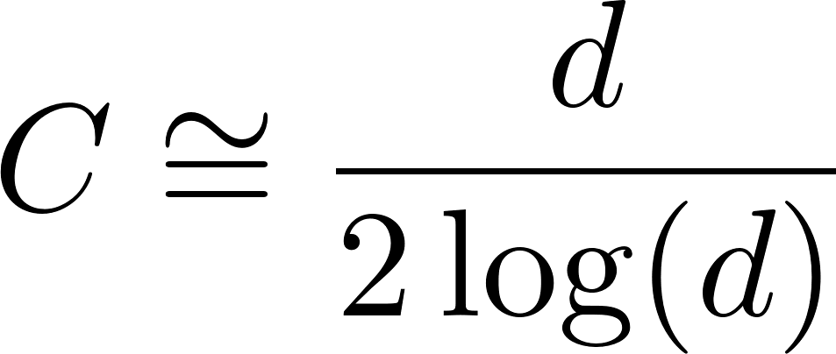
Associative Memory | Hopfield Neural Networks | AM & HNN
Six pattern?
Clearly, retrieving the patterns is imperfect. One might suspect that the limited storage capacities of Hopfield Networks [1]
The storage capacity for retrieval of patterns free of errors is [2]:
where d is the dimension of the input.
[1] Torres, J. J., Pantic, L., & Kappen, H. J. (2002). Storage capacity of attractor neural networks with depressing synapses. Physical Review E, 66(6), 061910.
[2] Ramsauer, H., Schäfl, B., Lehner, J., Seidl, P., Widrich, M., Adler, T., ... & Hochreiter, S. (2020). Hopfield networks is all you need. arXiv preprint arXiv:2008.02217.
Notes:
we show now that the storage capacity is not directly responsible for the imperfect retrieval.

Slide 14
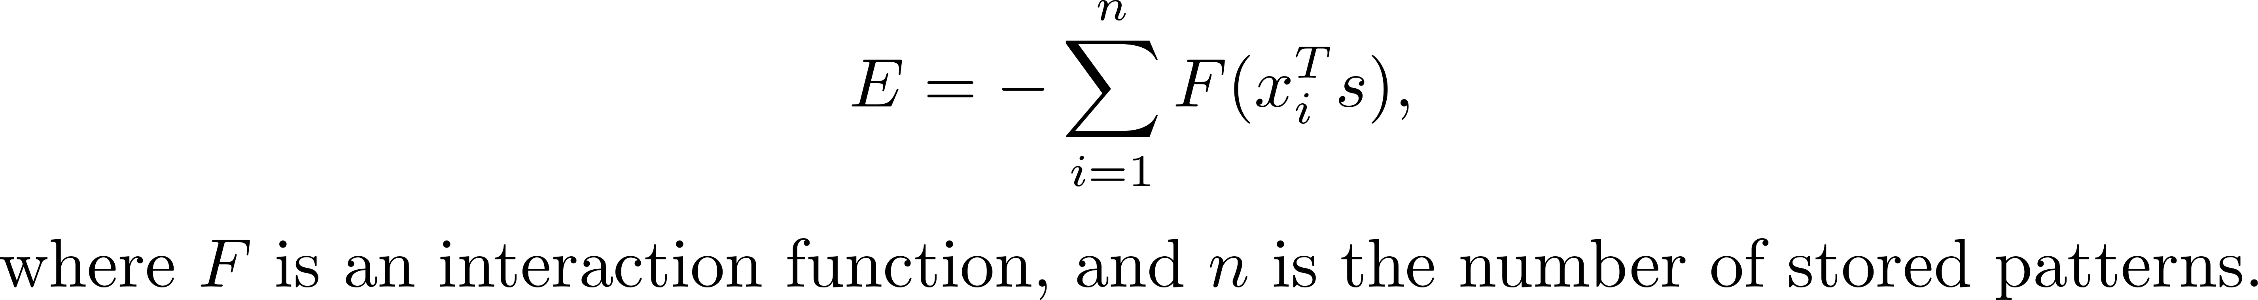
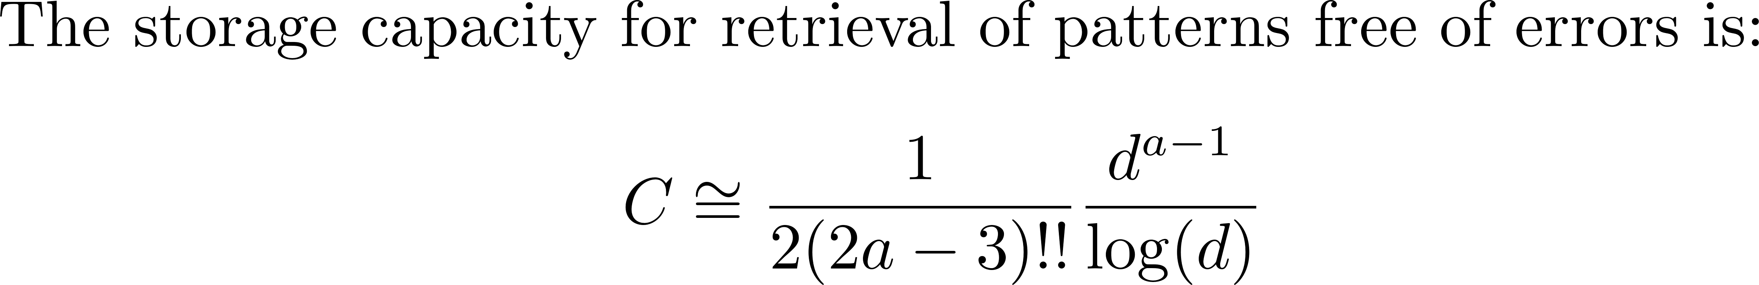
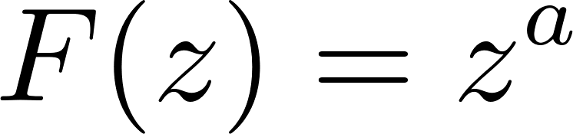
Associative Memory | Hopfield Neural Networks | AM & HNN
Modern Hopfield Networks (aka Dense Associative Memories)
Discrete modern Hopfield Networks [1]:
choose a polynomial interaction function
[1] Krotov, D., & Hopfield, J. J. (2016). Dense associative memory for pattern recognition. Advances in neural information processing systems, 29.

Slide 15
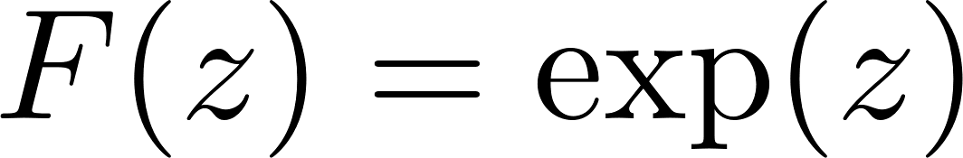
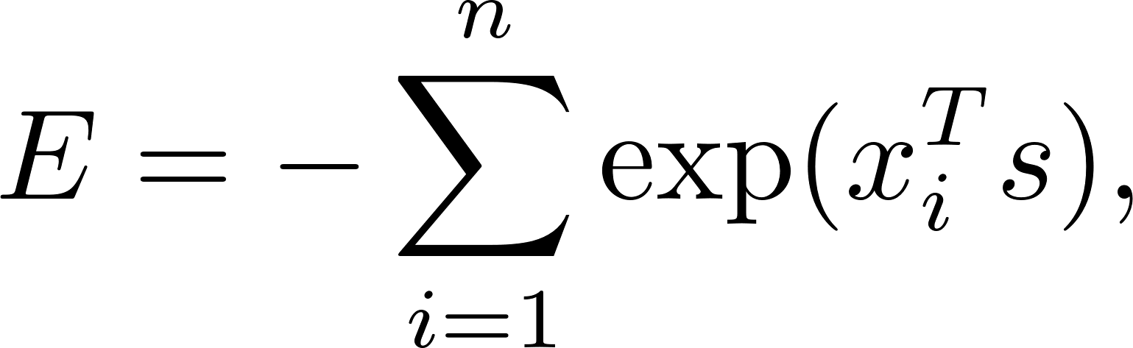
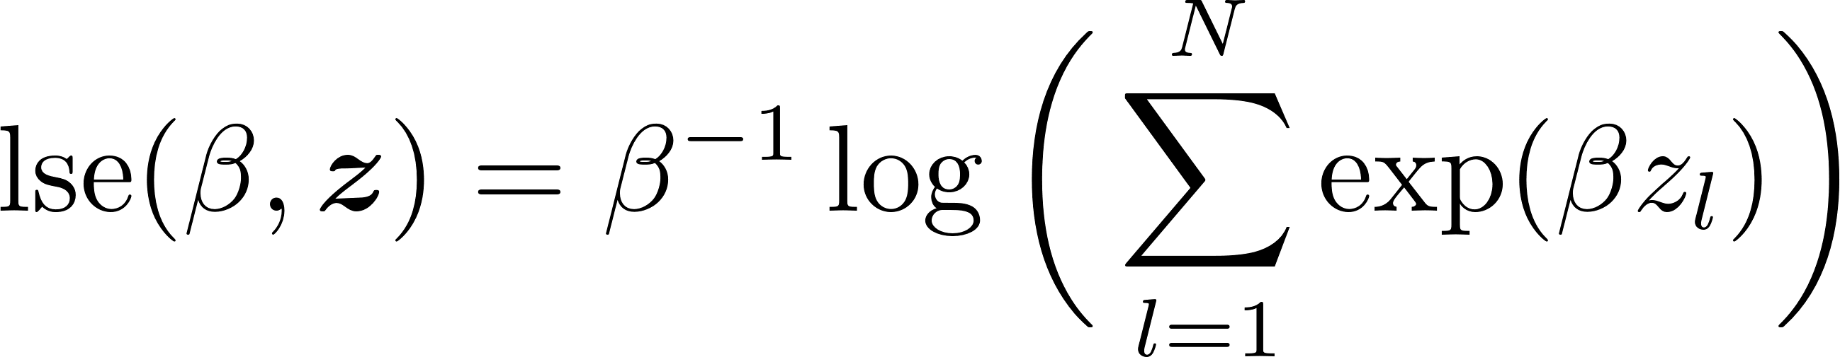
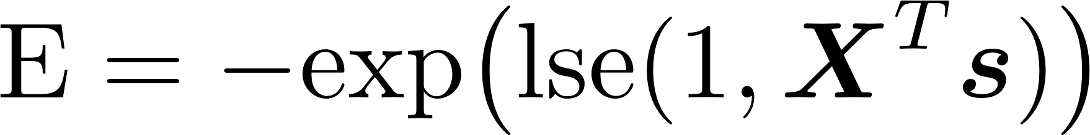

Associative Memory | Hopfield Neural Networks | AM & HNN
Modern Hopfield Networks (aka Dense Associative Memories)
[1] extended the energy function by using an exponential interaction function
log-sum-exp function
[1] Demircigil, M., Heusel, J., Löwe, M., Upgang, S., & Vermet, F. (2017). On a model of associative memory with huge storage capacity. Journal of Statistical Physics, 168, 288-299.

Slide 16
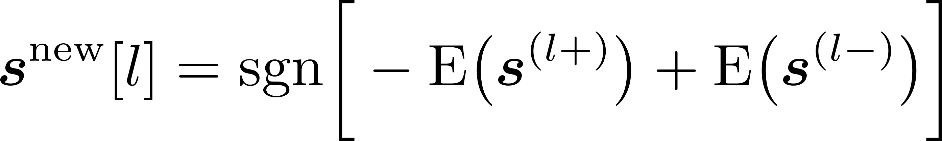
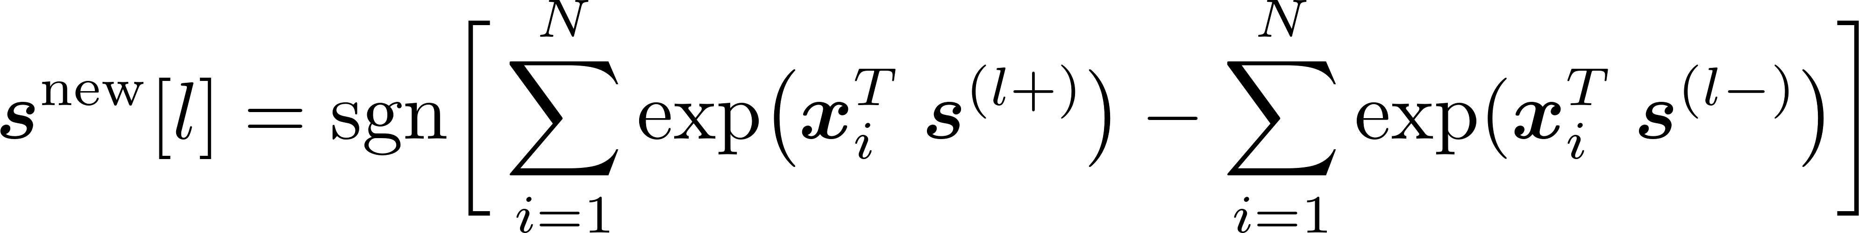
Associative Memory | Hopfield Neural Networks | AM & HNN
The update rule
In contrast to classical Hopfield Networks, modern Hopfield Networks do not have a weight matrix W.

Slide 17
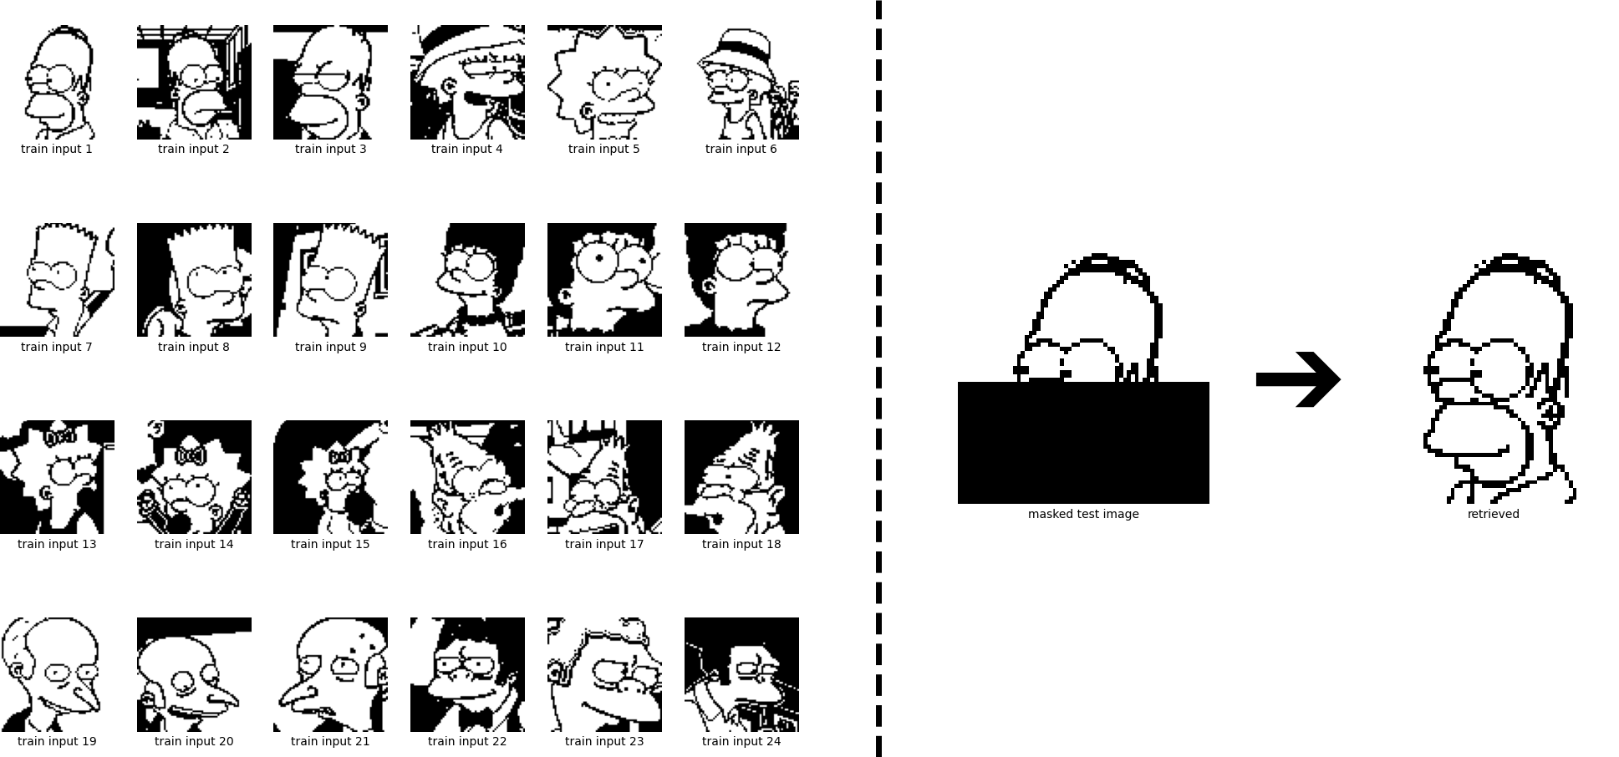
Associative Memory | Hopfield Neural Networks | AM & HNN
Six pattern?
24 pattern?

Slide 18
Associative Memory | Hopfield Neural Networks | AM & HNN
Continuous-valued patterns and states?
Generalize [1]
the largest norm of all stored patterns.
[1] Ramsauer, H., Schäfl, B., Lehner, J., Seidl, P., Widrich, M., Adler, T., ... & Hochreiter, S. (2020). Hopfield networks is all you need. arXiv preprint arXiv:2008.02217.

Slide 19
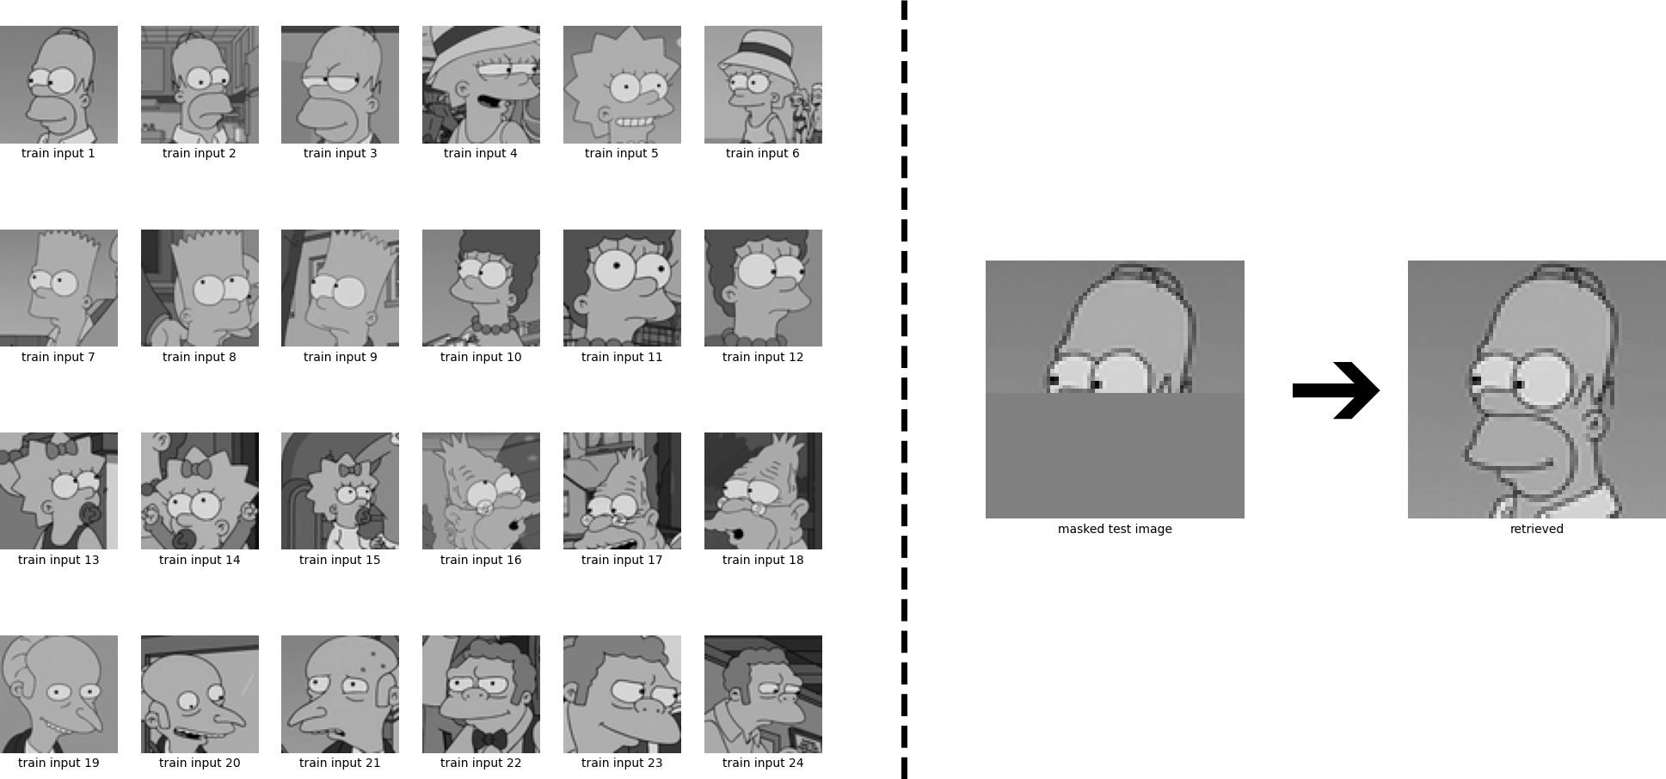
Associative Memory | Hopfield Neural Networks | AM & HNN

Slide 20
Thanks

